Slide 1
MDC Student Portal

Slide 2
Hello!
Group 1
Zeshyrou B. Anober
Mae Ann Salutan
Marilyn Cosadio
Sharmine Babatuan

Slide 3
General Problems
Mater Dei College used manual distributing of grades.
Time consuming for a student to get her/his grade.
Sometimes students outdated of the school updates and activities.
Population in the institution is rapidly increasing.
As an Information Technology Student of this institution ,We had experience with these problems and is therefore find solution for such.

Slide 4
THE SOLUTION
To provide single and a private place for a student where they can automatically download their grades and be guided through accurate information's.

Slide 5
Features General Requirements
Must have user access control through a functional log in system.
Must be capable of producing hard-copy output of the grade.
Must have a capability of posting.
Must be intuitive enough for non-IT students to use with minimal training and supervision.

Slide 6



Technical Background

Slide 7
Context Diagram
request
Information/grades
MDC
Student Portal
student
admin
Information/grades
request

Slide 8
Use Case Diagram
Student
Admin
Log In
Log In
👨
👦
View Announcements
Post
Announcements
View /Download
Grades
Upload Grades
Feedbacks
Update Accounts
Update Account

Slide 9
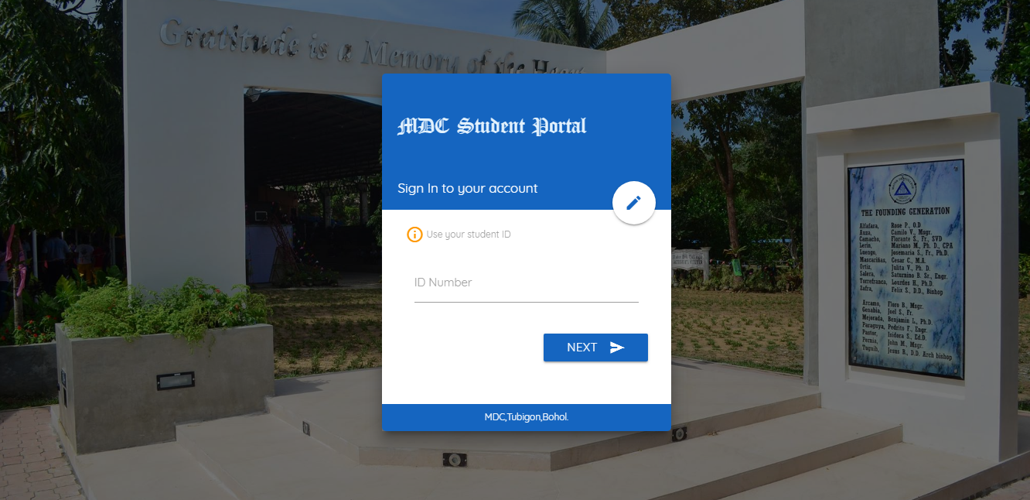
Please watch our SOFTWARE demo.
Place your screenshot here

Slide 10
Scope and Limitations
It can only be used for Mater Dei College department.
The system does not cover the paying of fees.
The system does not provide a live chat function.
The portal does not support enrollment.
The portal does generate grade by semester only.
A student must have only one account.
A student can only view and download their present subject enrolled.
A student can only view events, updates and announcements,school and system faq’s.

Slide 11
Scope and Limitations
Administrator have a total access to the system, generating a verifications that would be used by the student for creating their account in the portal. To post an updates and announcements, to create an event for the school year calendar.
The system gives further information about the school and the system itself.
A student can only view about the updates,announcements and events.

Slide 12
Future Enhancement
Online Enrollment
Online requesting of files
Online paying of fees

Slide 13
Thanks !
Any Questions ?
Group 1 – MDC Student Portal

